Slide 1
Anime Recommender Engine
By Chris Gray

Slide 2
Why Anime?
Anime is becoming more and more popular not only in the U.S. but worldwide. That being said current recommenders on video streaming services SUCK!
Netflix
Hulu
Crunchyroll

Slide 3


Netflix
Attack on Titan
Post Apocalyptic World Where Man-Eating Titans Have Wiped Out Most of the Population and the Few Remaining Humans Hide Behind the Safety of Huge Walls. When the Outer Wall is Broken Through They Are Forced to Stand up and Fight.
Ouran High School Host Club
A Poor Student Attending a High School for the Rich and Elite Via Scholarship, But Ends Up Breaking a Vase Belonging to the School’s Host Club that was Worth 8 Million Yen. As a Result He Must Work in the Host Club to Pay Off the Debt. Only Problem is He is Actually a She…

Slide 4




Netflix
=
=
=

Slide 5



Hulu
Supernatural
Action, Comedy, Super Power, Shounen
Supernatural
Action, Drama, Horror, Mystery, Psychological, Seinen
Action, Adventure, Comedy, Fantasy, Kids

Slide 6
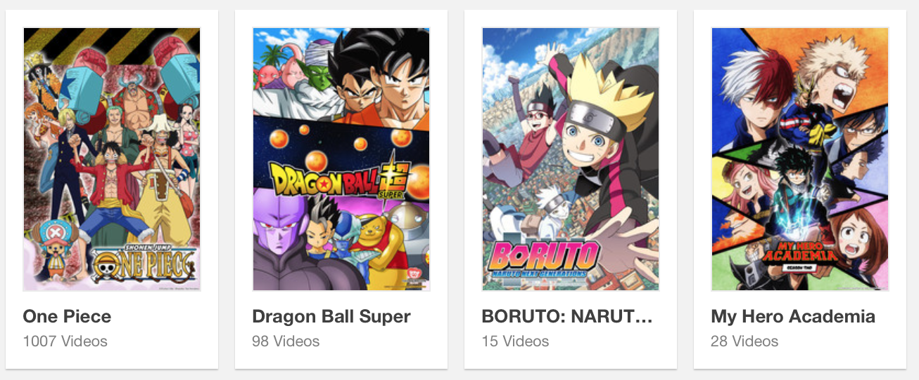
Crunchyroll
User 1 Recommendations
User 2 Recommendations
User 3 Recommendations
User 4 Recommendations

Slide 7
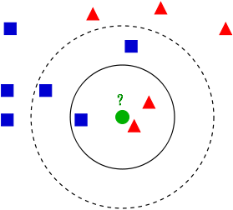
Genre Similarity Recommender
k-NN Classification

Slide 8










Genre Similarity Recommender

Slide 9





Popularity Engine
Removed Anime With < 2000 Ratings
Train/Test 80/20 Split
RSME – measures difference between predicted and actual values
1.49273 → 1.02209

Slide 10
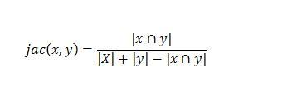
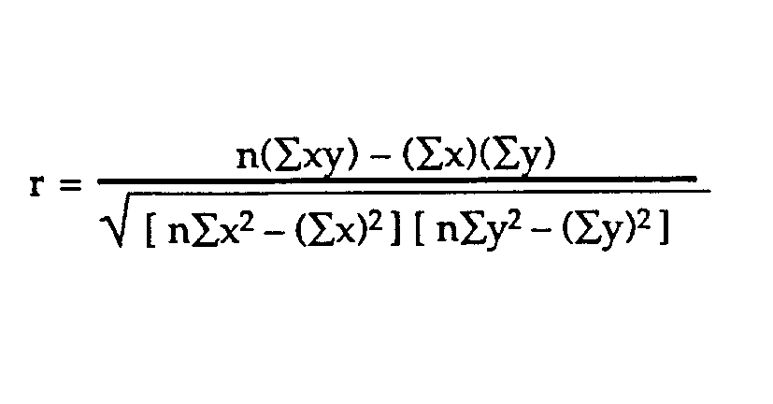
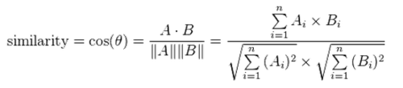
Collaborative Filtering Engine
Jaccard
Pearson
Cosine

Slide 11
Collaborative Filtering Engine
Jaccard – unuseable (only for binary/boolean)
Pearson – only considers titles that both users have rated
Cosine – similar to Pearson, but considers all titles users have rated

Slide 12
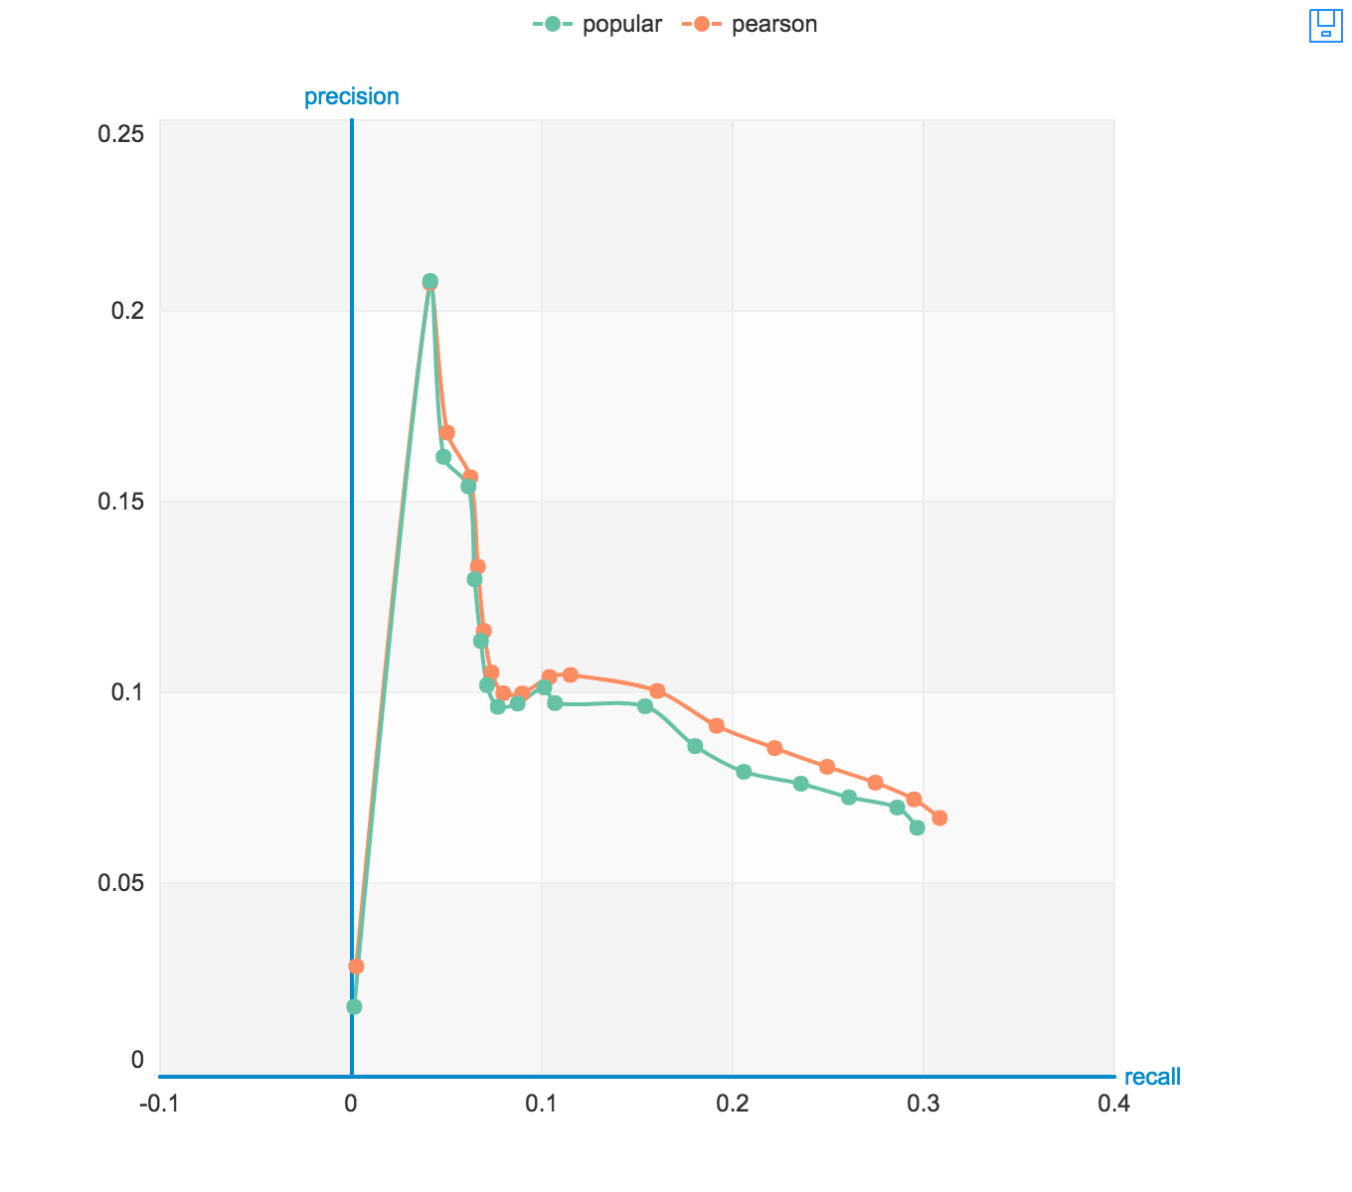
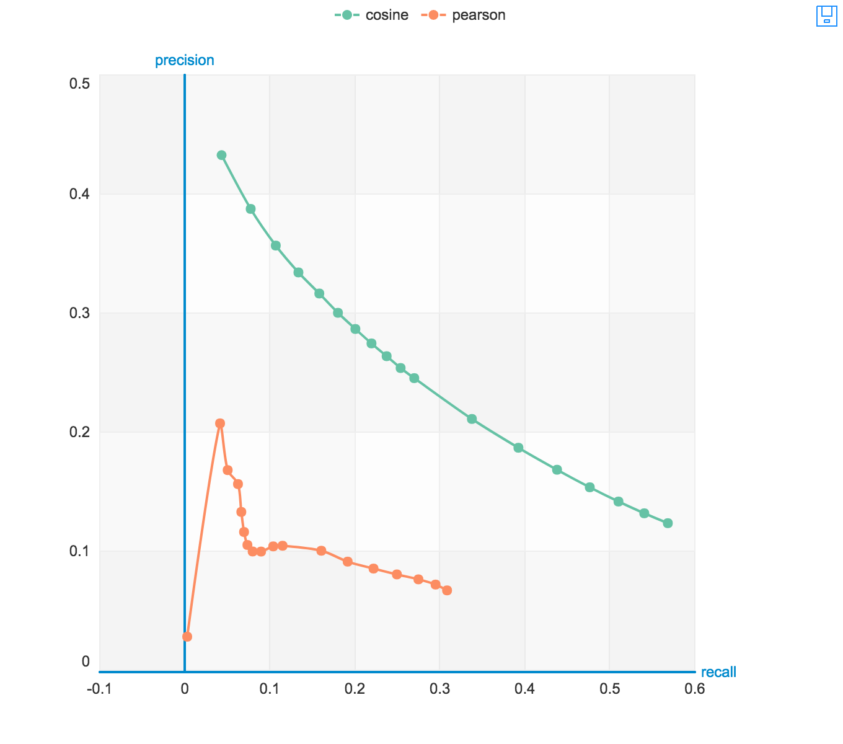
Popularity vs. Pearson vs. Cosine
Precision – the proportion of the results given that are actually “relevant”
Recall – the proportion of all “relevant” results are included in the results

Slide 13








Ricky’s Recommendations

Slide 14









Chris’ Recommendations

Slide 15


Christina’s Recommendations

Slide 16
Future Plans
Add More Anime Titles Back Into the Dataset
Create a Hybrid Recommender
Generate an Interactive Website
Get a Job!

Slide 17


